Slide 1
AI BASED FIRE EXTINGUISHING ROBOT
GROUP GUIDE-PROF SACHIN TAKMARE
GROUP MEMBERS-
SWAPNIL VERNEKAR
SUMAN SHREYAS
RISHABH JHA
SANDHYARANI THATIPAMULA

Slide 2
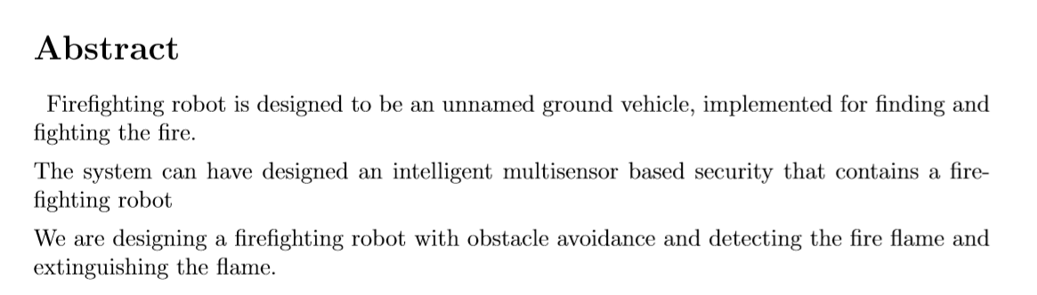

Slide 3
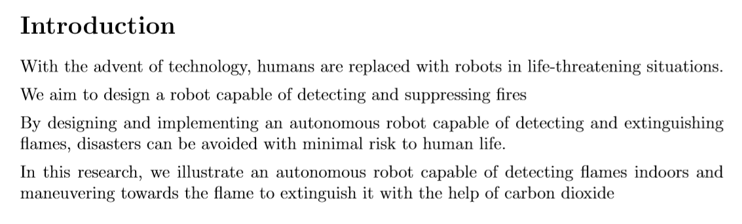

Slide 4
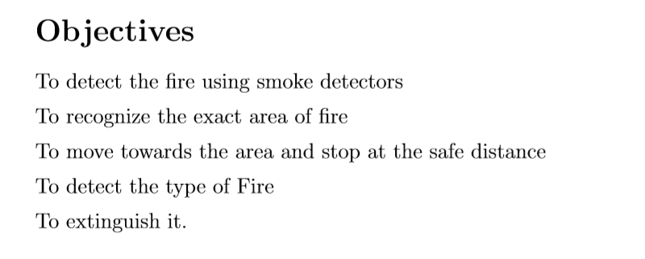

Slide 5
LITERATURE REVIEW
The idea of AI based fire fighting robot was emerged as there is no robot that is capable of tracking and extinguishing the fire autonomously in a particular area or region.
Our project will be successful with the help of number of sensors that will be used in the robot for sensing the environment.
We have researched a number of research papers for our project and got a lot of knowledge of the same.
RESEARCH PAPERS-
1-(IJARCCE Fire Fighting Robot Research paper)-We got the basic idea of the sensors and the hardware used.
2-(Rochester Institute of Technology)-Got the idea of the basic structure of the robotic car and the behaviour of the number of sensors in the fire environment.
3-(Fire Locator,Detector and Extinguisher)-How to connect the various sensors to the hardware of the car.

Slide 6
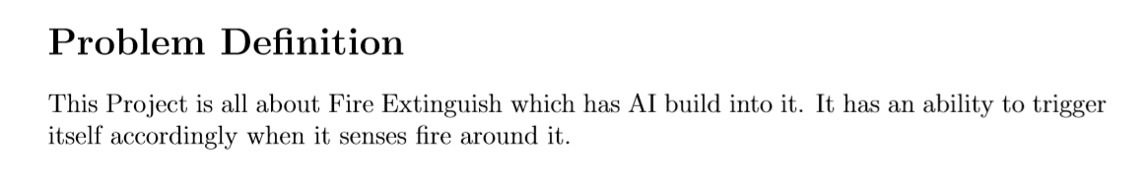

Slide 7
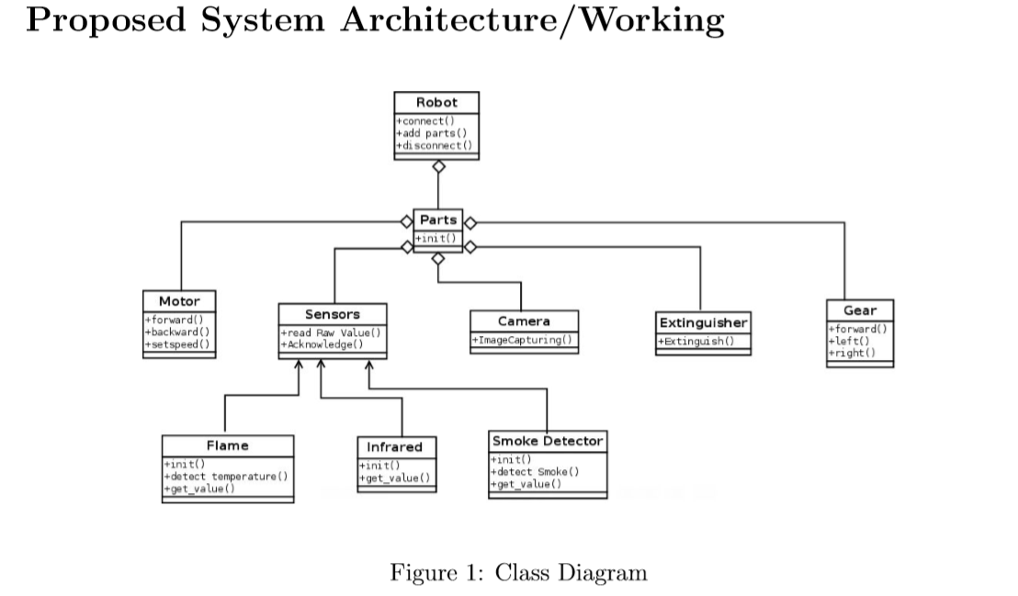

Slide 8
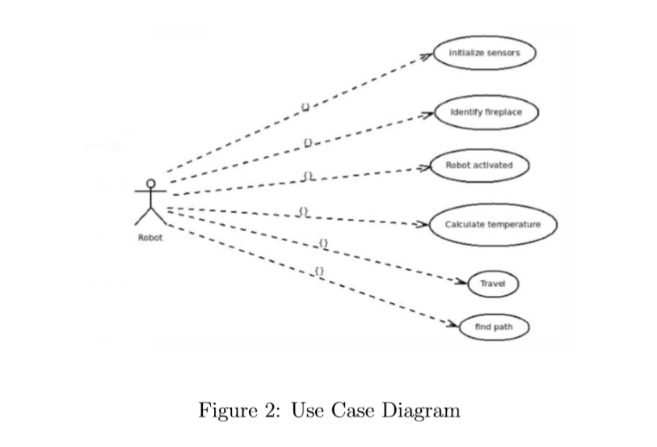

Slide 9
